Slide 1

CSCE 2017 ICAI 2017
Las Vegas
July. 17

Slide 2
Loading Discriminative Feature Representations in Hidden Layer
Daw-Ran Liou Yang-En Chen Cheng-Yuan Liou
Dept of Computer Sci and Information Eng National Taiwan University

Slide 3
Hinton, et al 2006 The “optimal spaced codes” is unclear and can hardly be accomplished by any learning algorithms for reduced Boltzmann machine.

Slide 4
Deep learning
Loading similar features.
(partial plus global features)

Slide 5
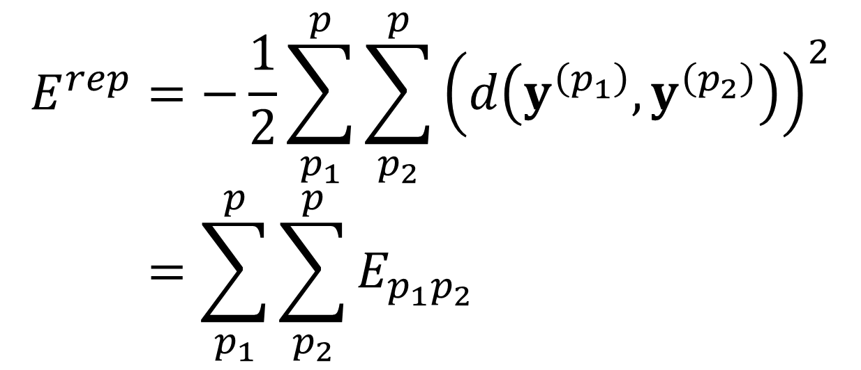
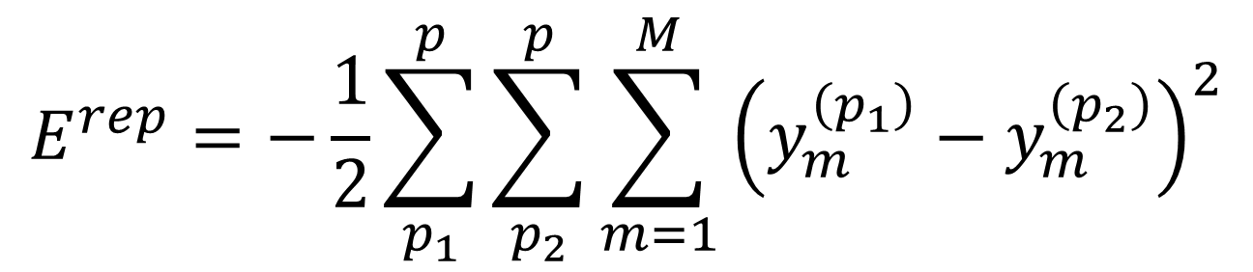
Proposed object fctn: different classes
$$E^{rep}=−\frac{1}{2}\sum_{p_{1}}^{p}{\sum_{p_{2}}^{p}{\sum_{m=1}^{M}{{\left(y_{m}^{\left(p_{1}\right)}−y_{m}^{\left(p_{2}\right)}\right)}^{2}}}}$$

Slide 6
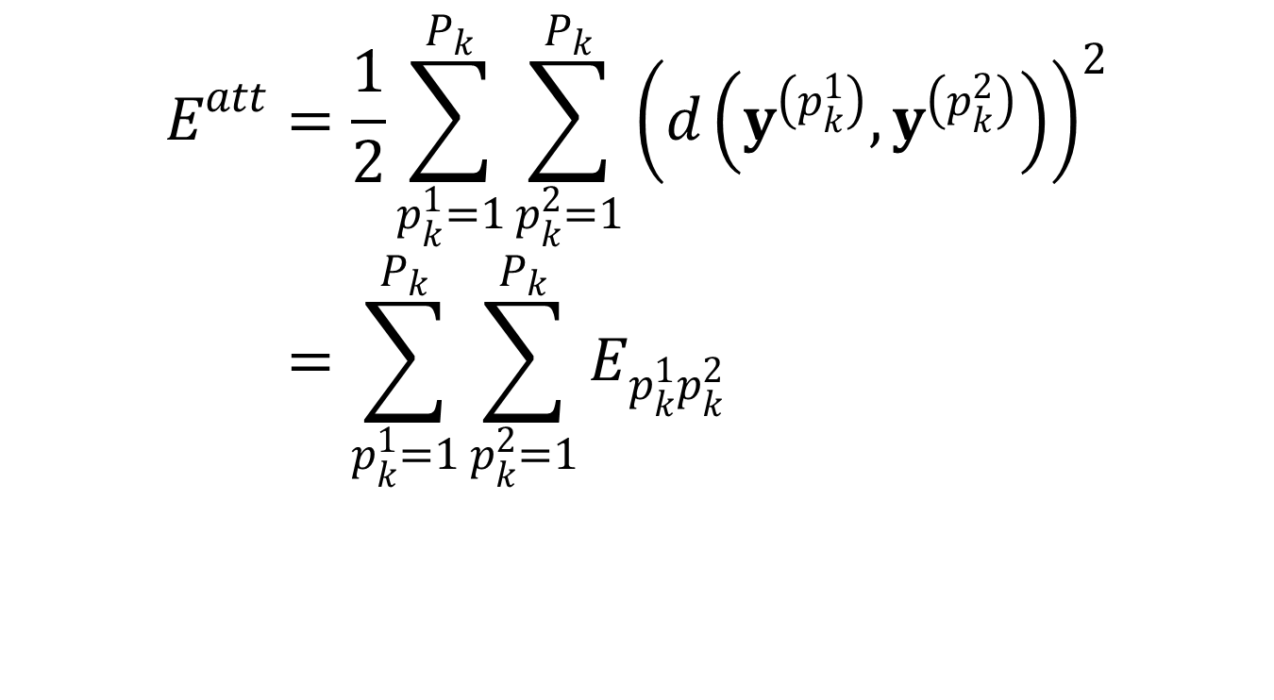
Object fctn: same class
$$E^{att}=\frac{1}{2}\sum_{p_{k}^{1}=1}^{P_{k}}{\sum_{p_{k}^{2}=1}^{P_{k}}{{\left(d\left(y^{\left(p_{k}^{1}\right)},y^{\left(p_{k}^{2}\right)}\right)\right)}^{2}}} \\ =\sum_{p_{k}^{1}=1}^{P_{k}}{\sum_{p_{k}^{2}=1}^{P_{k}}{E_{p_{k}^{1}p_{k}^{2}}}}$$

Slide 7
Similar architecture

Slide 8
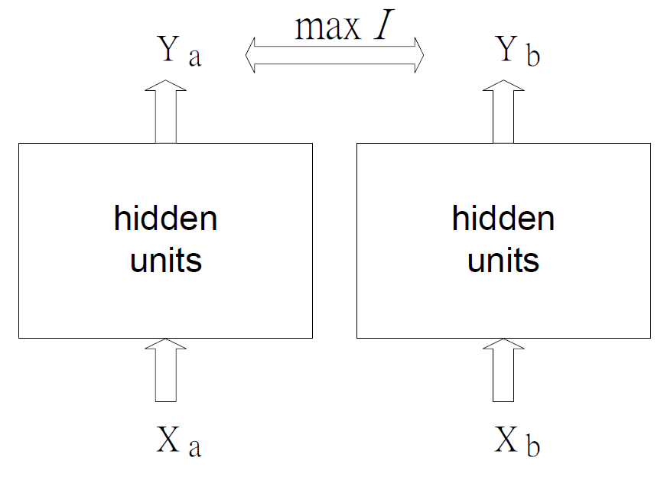
Becker and Hinton, 1992

Slide 9
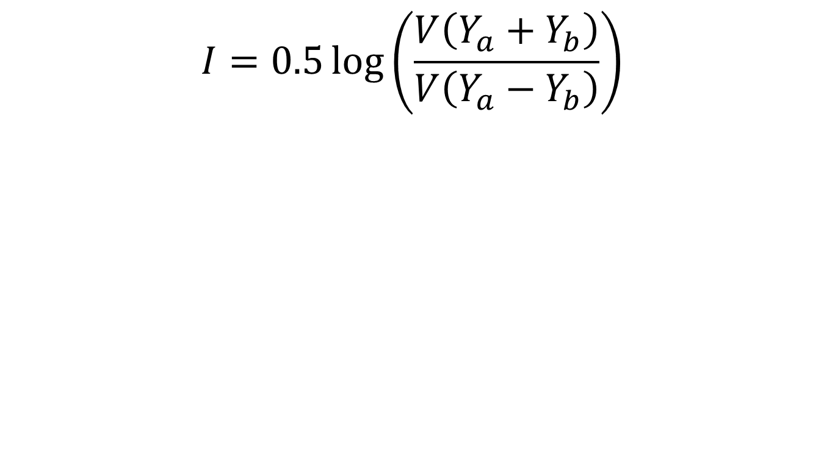
Becker and Hinton, 1992
mutual information
two modules

Slide 10
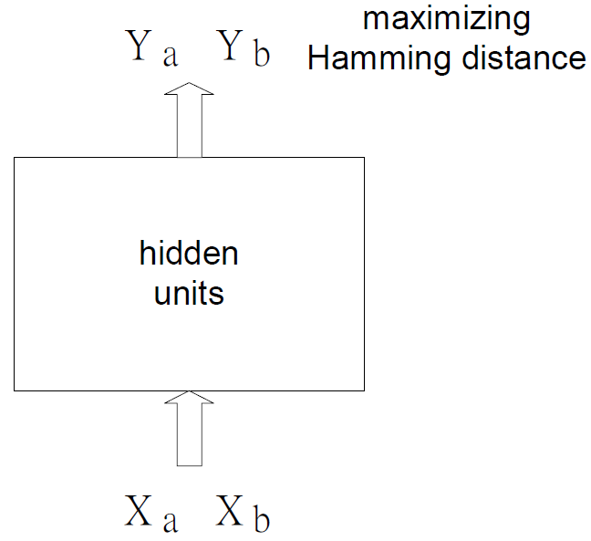
Proposed: single module

Slide 11








Three hidden layers
$$y$$
$$z$$
$$o$$
$$l$$
$$k$$
$$j$$
$$i$$
$$u$$
$$v$$
$$w$$

Slide 12

Different class patterns
$$E^{rep}=−\frac{1}{2}\sum_{p_{1}=1}^{P}{\sum_{p_{2}=1}^{P}{\sum_{i=1}^{I}{{\left(o_{i}^{\left(p_{1}\right)}−o_{i}^{\left(p_{2}\right)}\right)}^{2}}}}$$

Slide 13
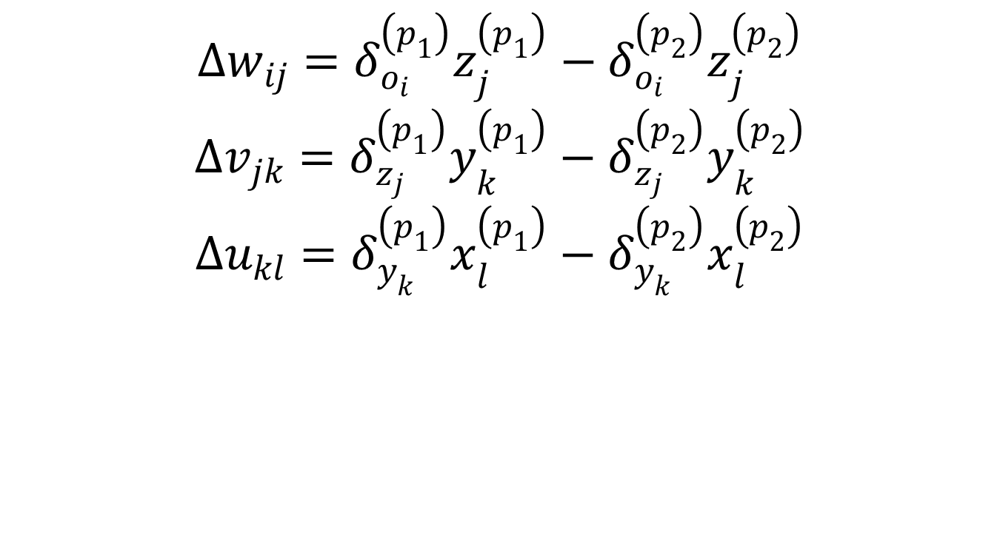
Training formulas
$$∆w_{ij}=δ_{o_{i}}^{\left(p_{1}\right)}z_{j}^{\left(p_{1}\right)}−δ_{o_{i}}^{\left(p_{2}\right)}z_{j}^{\left(p_{2}\right)}$$
$$∆v_{jk}=δ_{z_{j}}^{\left(p_{1}\right)}y_{k}^{\left(p_{1}\right)}−δ_{z_{j}}^{\left(p_{2}\right)}y_{k}^{\left(p_{2}\right)}$$
$$∆u_{kl}=δ_{y_{k}}^{\left(p_{1}\right)}x_{l}^{\left(p_{1}\right)}−δ_{y_{k}}^{\left(p_{2}\right)}x_{l}^{\left(p_{2}\right)}$$

Slide 14

52 patterns 16X16 pixels (26+26)

Slide 15
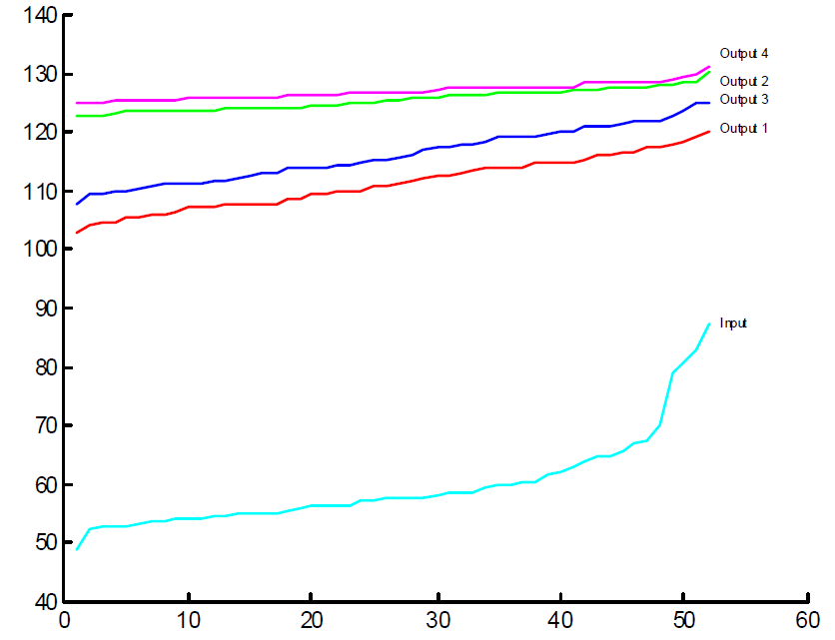
Sorted minimum Hamming distances for the 52 representations

Slide 16
The minimum distances for all patterns are all less than 90 (the curve marked with -input-).
Single layer
-output 1- obtained by orthogonal initial weights.
-output 2- obtained by small random initial weights.
3 hidden layers
-output 3- is obtained by orthogonal initial weights
-output 4- is obtained by random initial weights

Slide 17
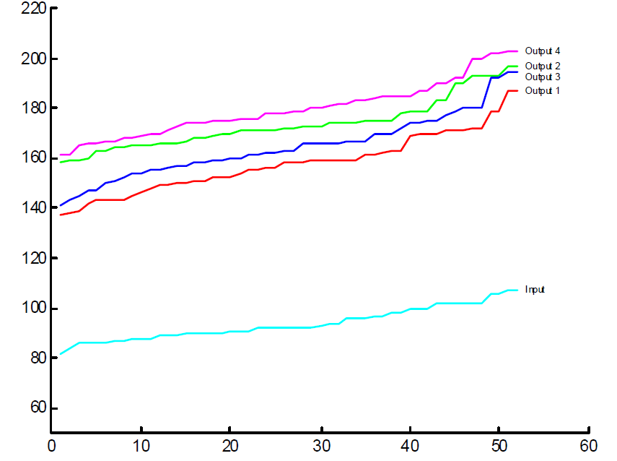
Sorted maximum Hamming distance between a representation and all others

Slide 18
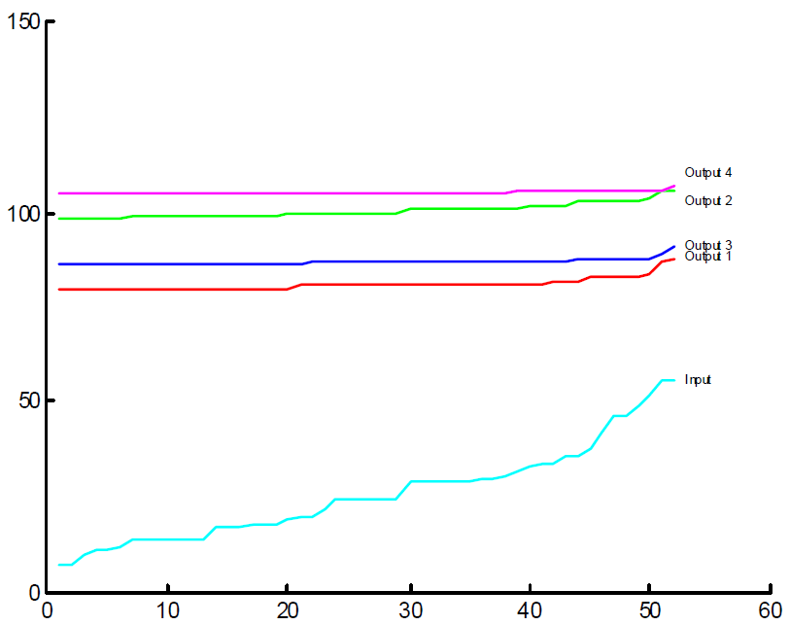
Sorted averaged Hamming distance for each representation

Slide 19
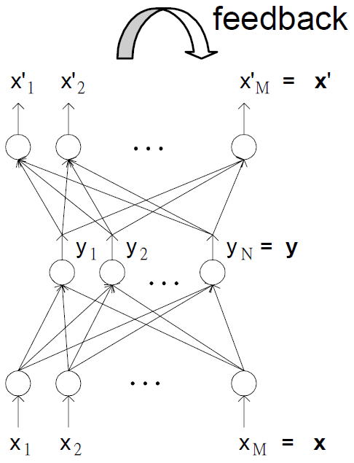
Restoration of noisy patterns

Slide 20
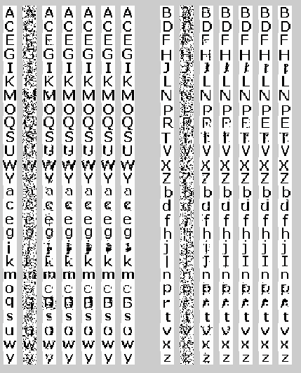
Restoration

Slide 21
Single layer Set weights as logic combinations of two patterns

Slide 22

Logic combinations of two patterns as discriminative weights Wij

Slide 23
Object fctn: two different patterns
$$E^{rep}=−\frac{1}{2}\sum_{p_{1}}^{p}{\sum_{p_{2}}^{p}{\sum_{m=1}^{M}{{\left(y_{m}^{\left(p_{1}\right)}−y_{m}^{\left(p_{2}\right)}\right)}^{2}}}}$$

Slide 24
Two different patterns white pixel represented by 1 black pixel represented by -1

Slide 25

Define four logic operations
$$\left\{\begin{aligned}Not: {\left[−1,1\right]}^{16×16}→{\left[−1,1\right]}^{16×16} \\ Not\left(\left[A\right]\right)=\left(Not \left[A\right]\right)=\left[R\right], \\ where {\left[R\right]}_{ij}=−{\left[A\right]}_{ij} ∀i,j=1,…,16\end{aligned}\right.$$

Slide 26

Define four logic operations
$$\left\{\begin{aligned}Or:{\left[−1,1\right]}^{16×16}×{\left[−1,1\right]}^{16×16}→{\left[−1,1\right]}^{16×16} \\ Or\left(\left[A\right],\left[B\right]\right)=\left(\left[A\right] Or \left[B\right]\right)=\left[R\right], \\ where {\left[R\right]}_{ij}=\max\left({\left[A\right]}_{ij},{\left[B\right]}_{ij}\right) ∀i,j=1,…,16\end{aligned}\right.$$

Slide 27

Define four logic operations
$$\left\{\begin{aligned}And:{\left[−1,1\right]}^{16×16}×{\left[−1,1\right]}^{16×16}→{\left[−1,1\right]}^{16×16} \\ And\left(\left[A\right],\left[B\right]\right)=\left(\left[A\right] And \left[B\right]\right)=\left[R\right], \\ where {\left[R\right]}_{ij}=\min\left({\left[A\right]}_{ij},{\left[B\right]}_{ij}\right) ∀i,j=1,…,16\end{aligned}\right.$$

Slide 28

Define four logic operations
$$\left\{\begin{aligned}Xor:{\left[−1,1\right]}^{16×16}×{\left[−1,1\right]}^{16×16}→{\left[−1,1\right]}^{16×16} \\ Xor\left(\left[A\right],\left[B\right]\right)=\left(\left[A\right] Xor \left[B\right]\right)=\left[R\right] \\ =\left(\left[A\right] And \left(Not \left[B\right]\right)\right) Or \left(\left[B\right] And \left(Not \left[A\right]\right)\right)\end{aligned}\right.$$

Slide 29
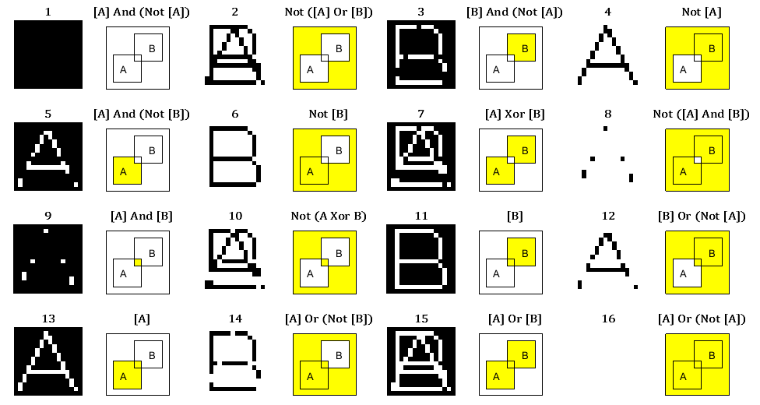
Total 16 logic combinations of {“A”,“B”}

Slide 30

Total 16 logic combinations of {“A”,“B”}

Slide 31
Total 16 logic combinations of {“A”,“B”}

Slide 32
Total 16 logic combinations of {“A”,“B”}

Slide 33
Total 16 logic combinations of {“A”,“B”}

Slide 34
Set the 256 weights as one of the 16 combinations Output value E of the output neuron

Slide 35
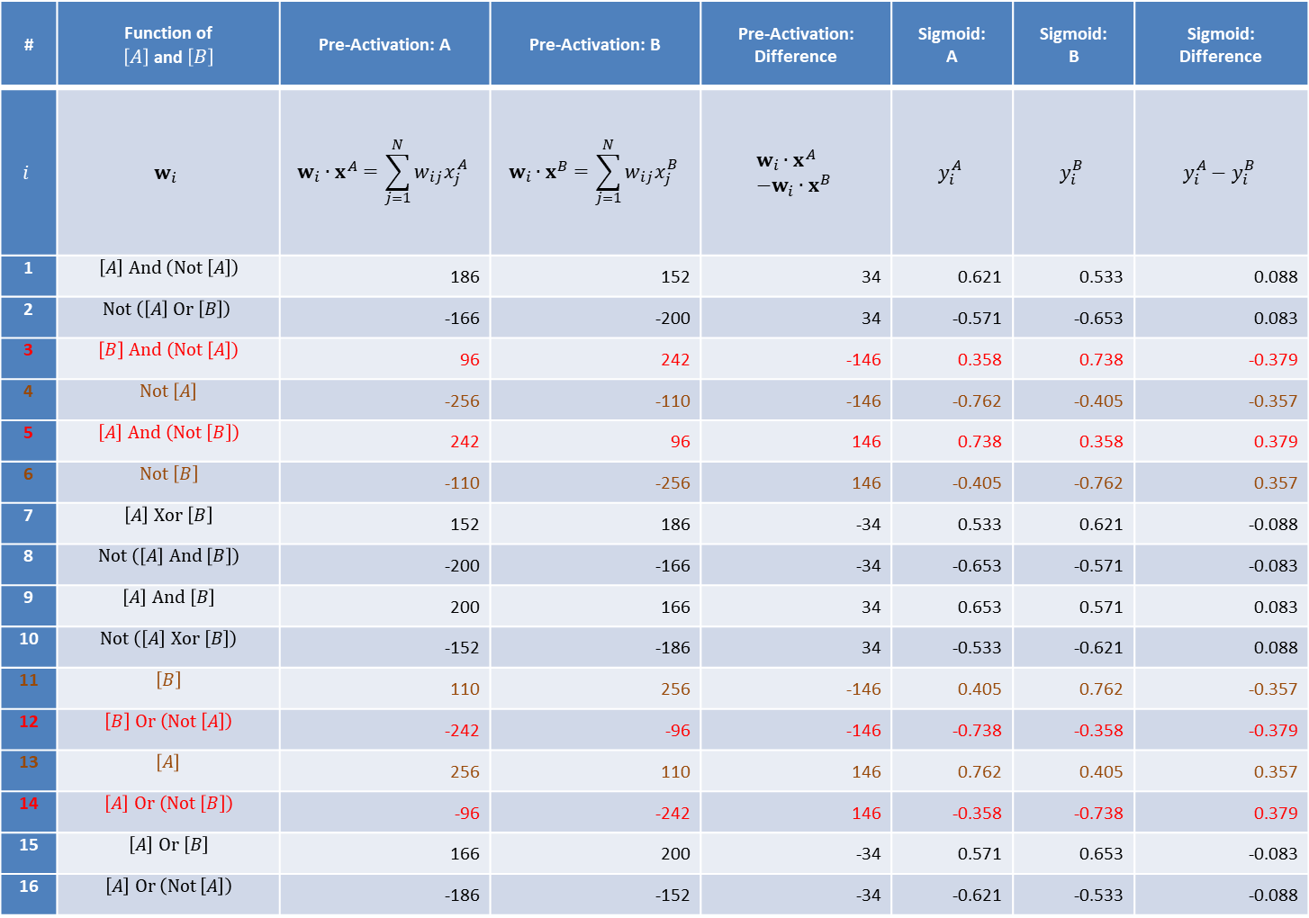
# | Function of $\left[A\right]$ and $\left[B\right]$ | Pre-Activation: A | Pre-Activation: B | Pre-Activation: Difference | Sigmoid: A | Sigmoid: B | Sigmoid: Difference
$$i$$ | $$w_{i}$$ | $$w_{i}∙x^{A}=\sum_{j=1}^{N}{w_{ij}x_{j}^{A}}$$ | $$w_{i}∙x^{B}=\sum_{j=1}^{N}{w_{ij}x_{j}^{B}}$$ | $$w_{i}∙x^{A} \\ −w_{i}∙x^{B}$$ | $$y_{i}^{A}$$ | $$y_{i}^{B}$$ | $$y_{i}^{A}−y_{i}^{B}$$
1 | $$\left[A\right] And \left(Not \left[A\right]\right)$$ | 186 | 152 | 34 | 0.621 | 0.533 | 0.088
2 | $$Not \left(\left[A\right] Or \left[B\right]\right)$$ | -166 | -200 | 34 | -0.571 | -0.653 | 0.083
3 | $$\left[B\right] And \left(Not \left[A\right]\right)$$ | 96 | 242 | -146 | 0.358 | 0.738 | -0.379
4 | $$Not \left[A\right]$$ | -256 | -110 | -146 | -0.762 | -0.405 | -0.357
5 | $$\left[A\right] And \left(Not \left[B\right]\right)$$ | 242 | 96 | 146 | 0.738 | 0.358 | 0.379
6 | $$Not \left[B\right]$$ | -110 | -256 | 146 | -0.405 | -0.762 | 0.357
7 | $$\left[A\right] Xor \left[B\right]$$ | 152 | 186 | -34 | 0.533 | 0.621 | -0.088
8 | $$Not \left(\left[A\right] And \left[B\right]\right)$$ | -200 | -166 | -34 | -0.653 | -0.571 | -0.083
9 | $$\left[A\right] And \left[B\right]$$ | 200 | 166 | 34 | 0.653 | 0.571 | 0.083
10 | $$Not \left(\left[A\right] Xor \left[B\right]\right)$$ | -152 | -186 | 34 | -0.533 | -0.621 | 0.088
11 | $$\left[B\right]$$ | 110 | 256 | -146 | 0.405 | 0.762 | -0.357
12 | $$\left[B\right] Or \left(Not \left[A\right]\right)$$ | -242 | -96 | -146 | -0.738 | -0.358 | -0.379
13 | $$\left[A\right]$$ | 256 | 110 | 146 | 0.762 | 0.405 | 0.357
14 | $$\left[A\right] Or \left(Not \left[B\right]\right)$$ | -96 | -242 | 146 | -0.358 | -0.738 | 0.379
15 | $$\left[A\right] Or \left[B\right]$$ | 166 | 200 | -34 | 0.571 | 0.653 | -0.083
16 | $$\left[A\right] Or \left(Not \left[A\right]\right)$$ | -186 | -152 | -34 | -0.621 | -0.533 | -0.088

Slide 36
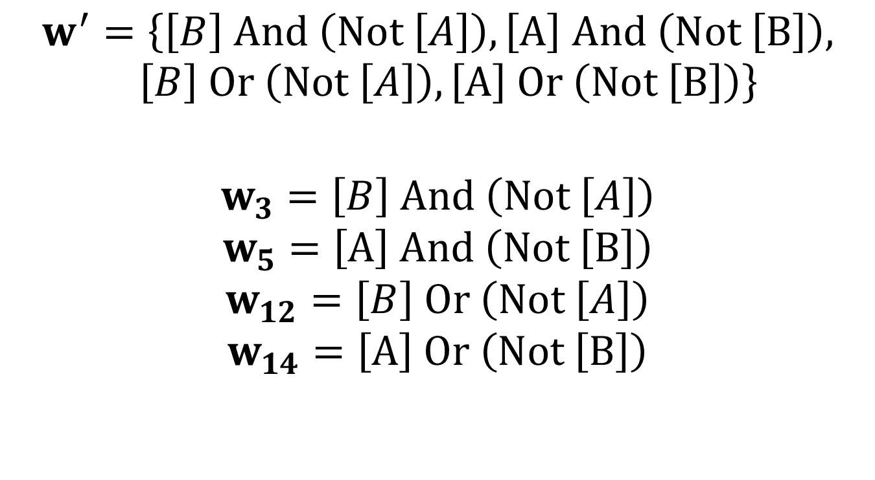
$$w^{′}=\left\{\left[B\right] And \left(Not \left[A\right]\right),\left[A\right] And \left(Not \left[B\right]\right), \left[B\right] Or \left(Not \left[A\right]\right),\left[A\right] Or \left(Not \left[B\right]\right)\right\}$$
$$w_{3}=\left[B\right] And \left(Not \left[A\right]\right)$$
$$w_{5}=\left[A\right] And \left(Not \left[B\right]\right)$$
$$w_{12}=\left[B\right] Or \left(Not \left[A\right]\right)$$
$$w_{14}=\left[A\right] Or \left(Not \left[B\right]\right)$$

Slide 37
Figures 3-8
black-white images
black for -1 and white for 1
red-black-green figures
intensity of green for the values from 0 to 1
black for 0
intensity of red for the values from 0 to -1

Slide 38
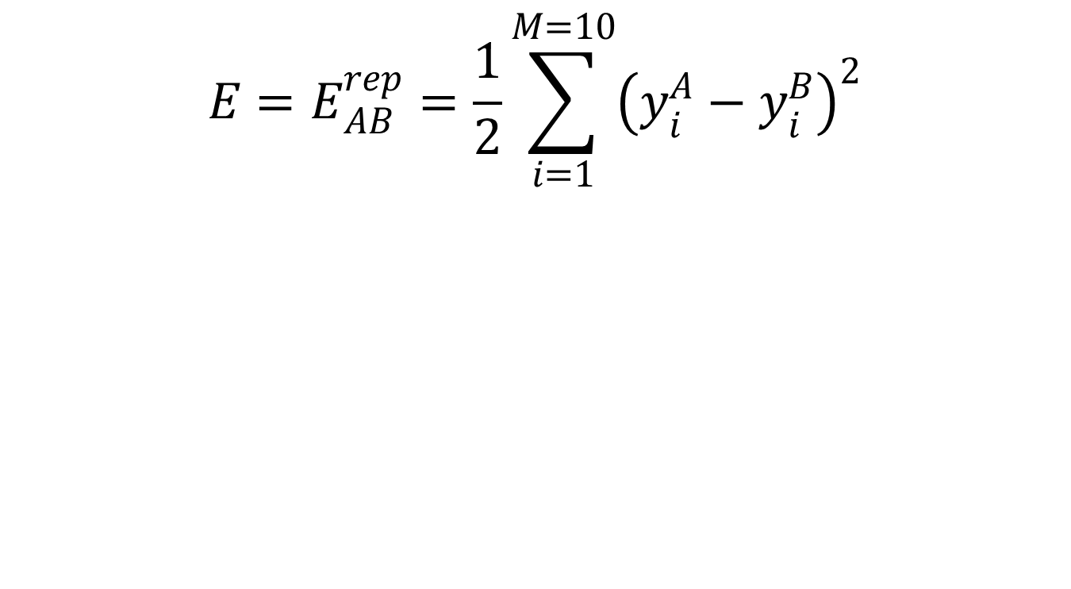
Single layer
Ten hidden neurons

Slide 39
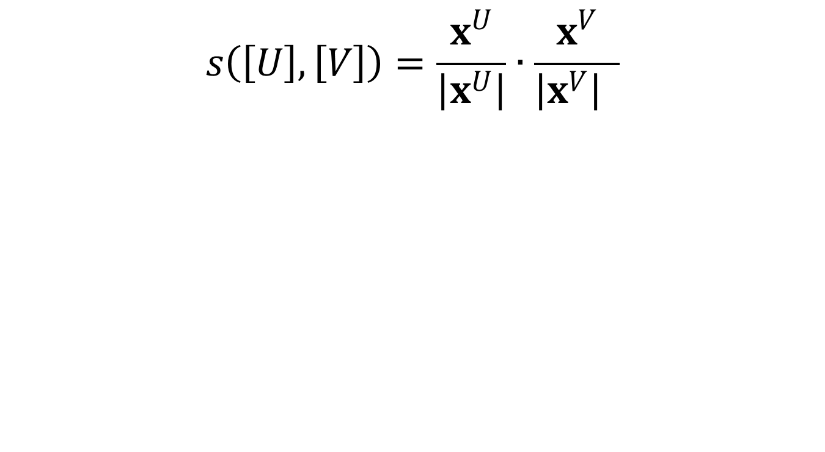
Similarity of two images [U] and [V]

Slide 40
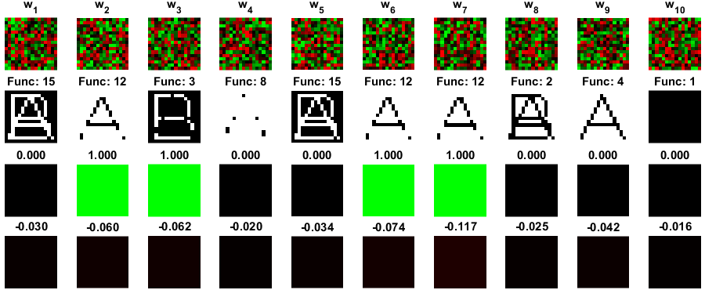
Initial weights with random numbers [-1,1]
Trained weight matrix in upper row
Its similar function/16 in bottom row
Trained weights similar to discriminative fctns 3,12.

Slide 41
Initial weights with random numbers [-1,1]
Row #
1. initial weights
2. most similar logic functions
3. (yA-yB)^2 / 4 : 1 (green) or 0 (black)

Slide 42
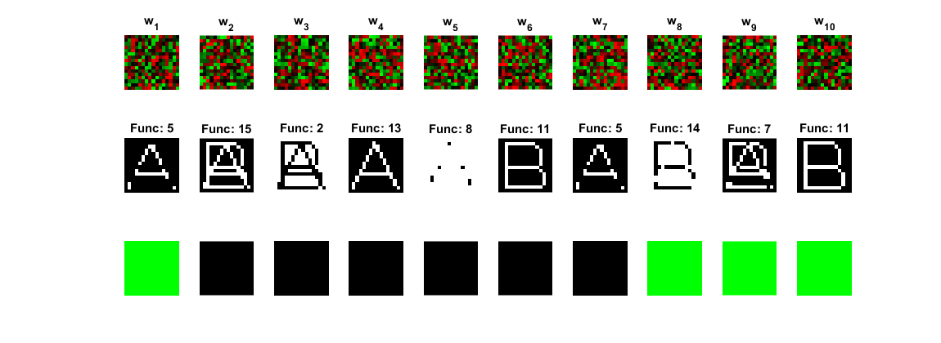

Slide 44
Initial weights with random numbers [-1,1]
Row #
1. initial weights
2. Logic functions中最相似的function
3. (yA-yB)^2 / 4 : 值為1 (green) or 0 (black)
4. Similarity to A-B

Slide 45
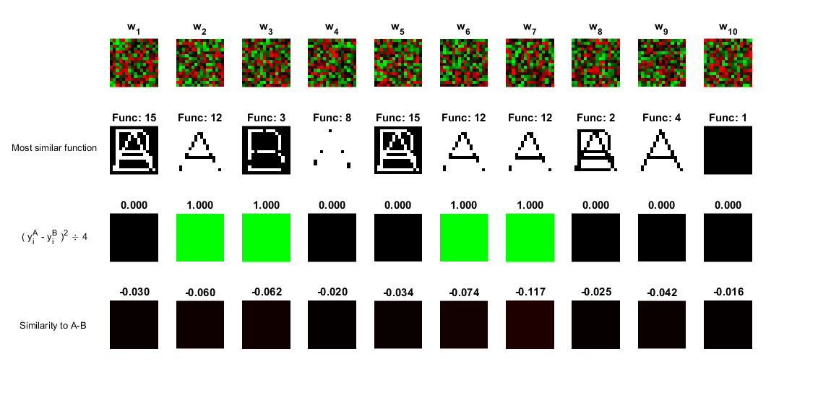

Slide 47
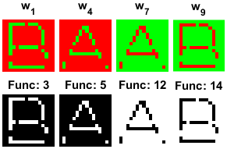
Initial weights in W’
Weight unchanged during training (technique problem with ~hard limited fctn)

Slide 48
Initial weights in W’
Row #
1. Initial weights
2. Trained weights
3. Logic functions中最相似的function
4. (yA-yB)^2 / 4
5. Similarity to A-B

Slide 49
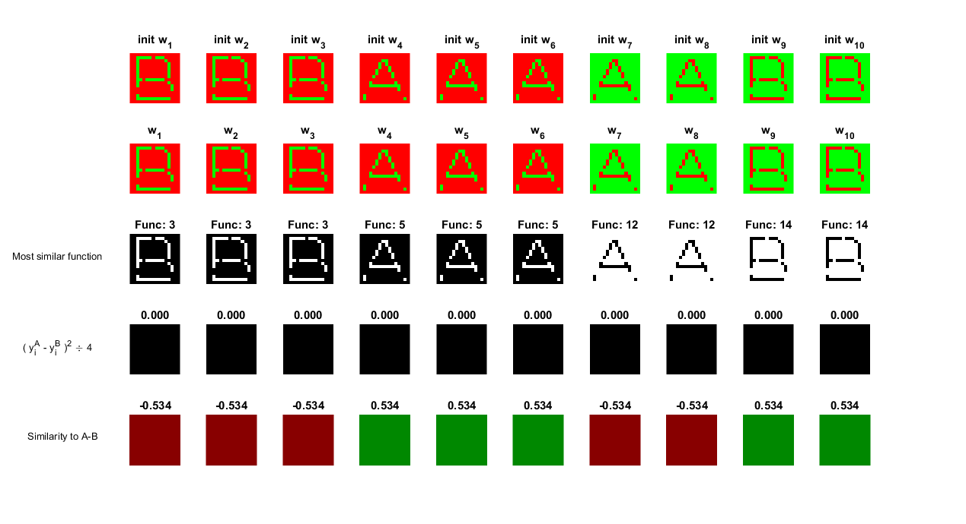

Slide 51
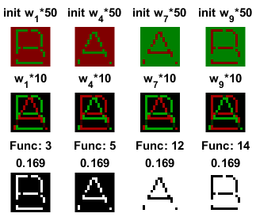
Initial weights in 0.001W’
Bottom row, similar discriminative fctns 3,5,12,14.
Trained weights=[A]-[B] or =its negative version.

Slide 52
Initial weights in 0.001W’
Row #
1. Initial weights
2. Trained weights
3. most similar logic functions + similarities
4. (yA-yB)^2 / 4
5. Similarity to A-B

Slide 53
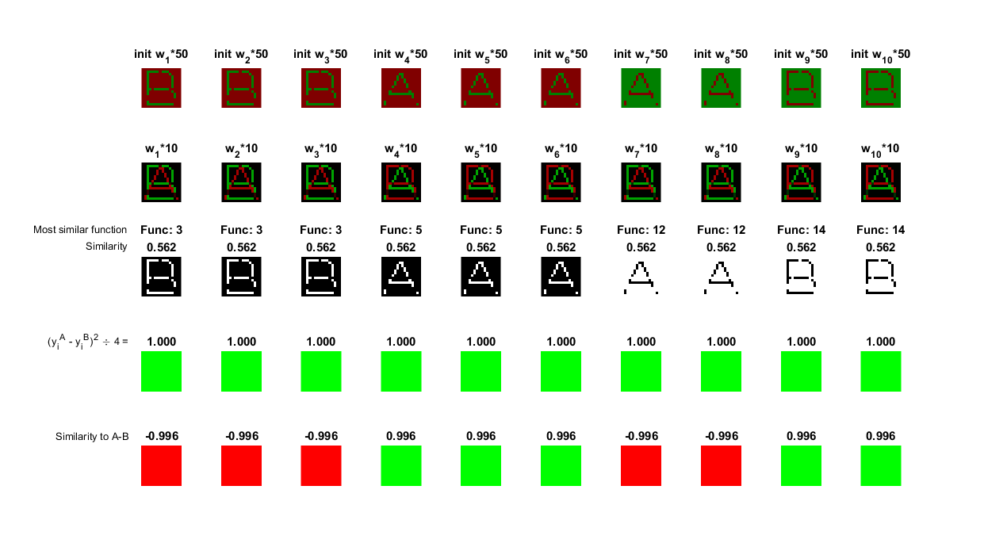

Slide 55
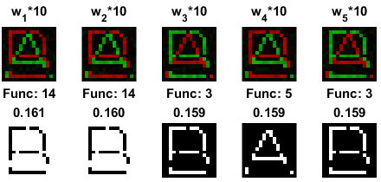
Initial W: small random number
Bottom row: similar fctns #3,5,14;
Trained weights = [A]-[B] or its negative version.

Slide 56
Initial W: small random number between [-0.01, 0.01]
Row #
1. Trained weights
2. most similar logic functions + similarities
3. (yA-yB)^2 / 4
4. Similarity to A-B

Slide 57
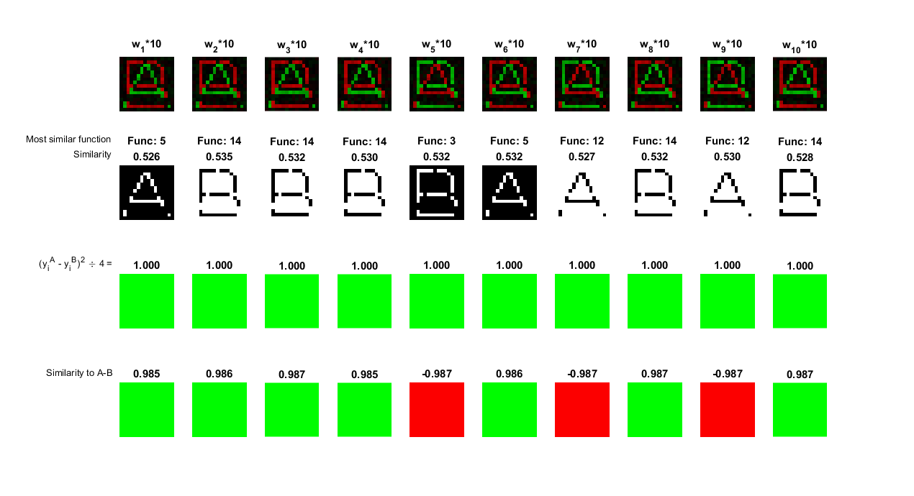

Slide 59
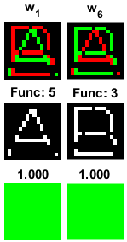
Initial weights as [A]-[B] or negative version
Optimal discriminative weights for distinguishing {A ,B}. Weights unchanged.

Slide 60
Initial weights as [A]-[B] or negative version
Row #
1. initial weights
2. Logic functions中最相似的function
3. (yA-yB)^2 / 4 : 全部為 1 (green)

Slide 61
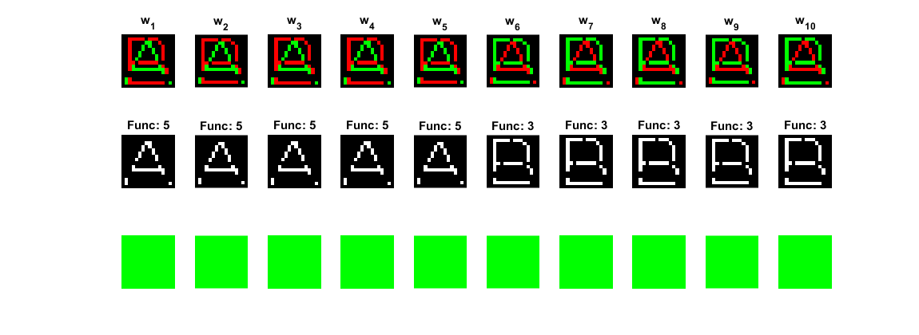

Slide 63
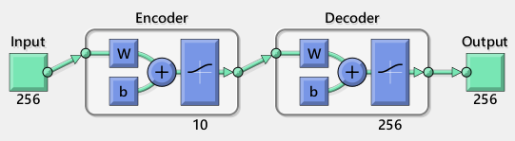
Autoencoder 256-10-256 (BP)
Autoencoder : Train an autoencoder - MATLAB trainAutoencoder.

Slide 64
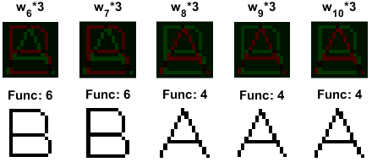
Autoencoder 256-10-256 (BP)
Bottom row: several similar features of the -10- hidden neurons

Slide 65
Autoencoder 256-10-256 (BP)
Trained with: Autoencoder
Row #
1. Trained weights
2. Logic functions中最相似的function
3. (yA-yB)^2 / 4
4. Similarity to A-B

Slide 66
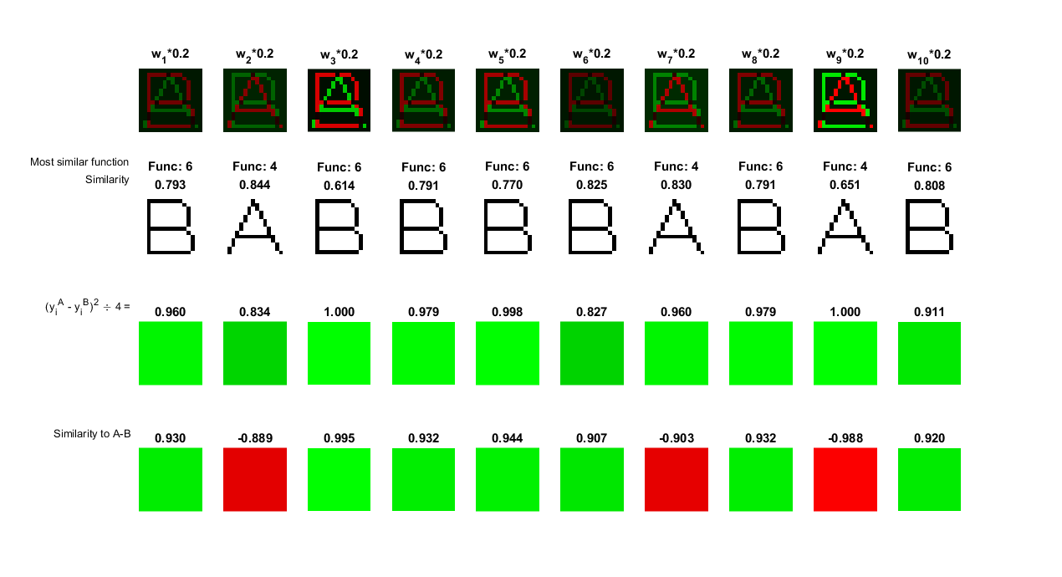

Slide 68
Autoencoder 256-10-256 (BP)
Trained with: Autoencoder
Row #
1. Trained weights
2. Logic functions中最相似的function
3. (yA-yB)^2 / 4

Slide 69
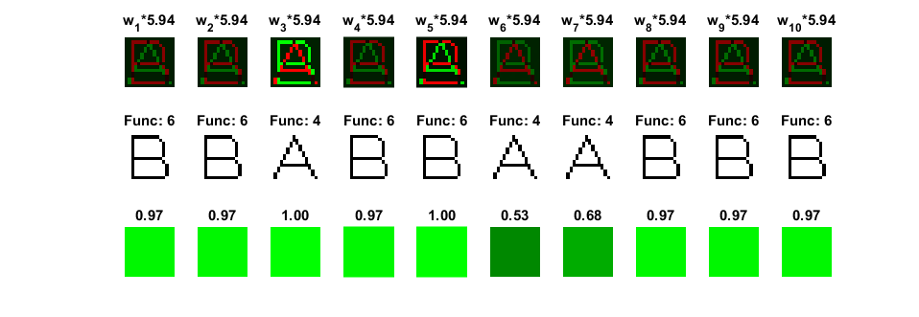

Slide 71
Exceeds that of logic operations.
[A]-[B] or [B]-[A]
Optimal discriminative weights.
Cannot be reached by logic combinations.

Slide 72
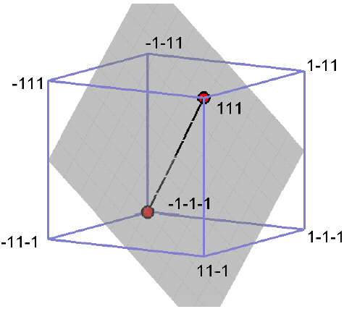
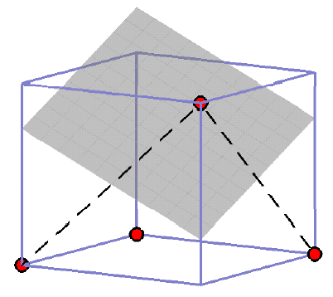
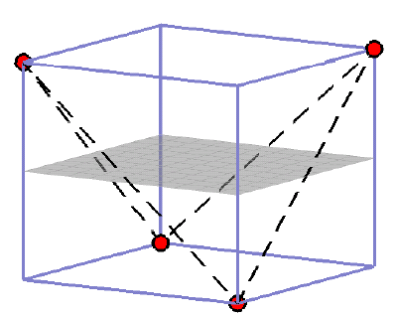
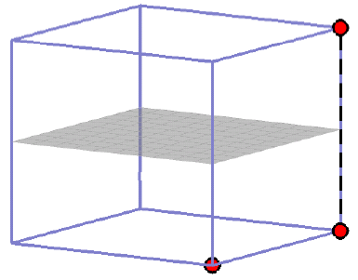
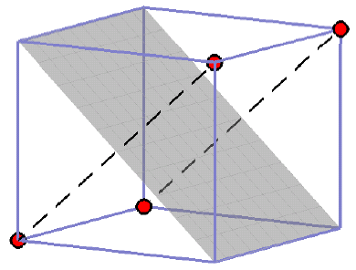
Optimal weights for [A] and [B] with three pixels
A
A
B
B₂
B₁
B₃
A₂
A₁
A
A₂
A₁
B₂
B₁
B₁
B₂
B₂
B₁

Slide 73
Optimal discriminative weights See Fig.1 in: Cheng-Yuan Liou (2006), Backbone structure of hairy memory, ICANN, The 16th International Conference on Artificial Neural Networks, September 10-14, in edited book published by LNCS 4131, Part I, pp 688-697

Slide 74
Biological plausibility

Slide 75
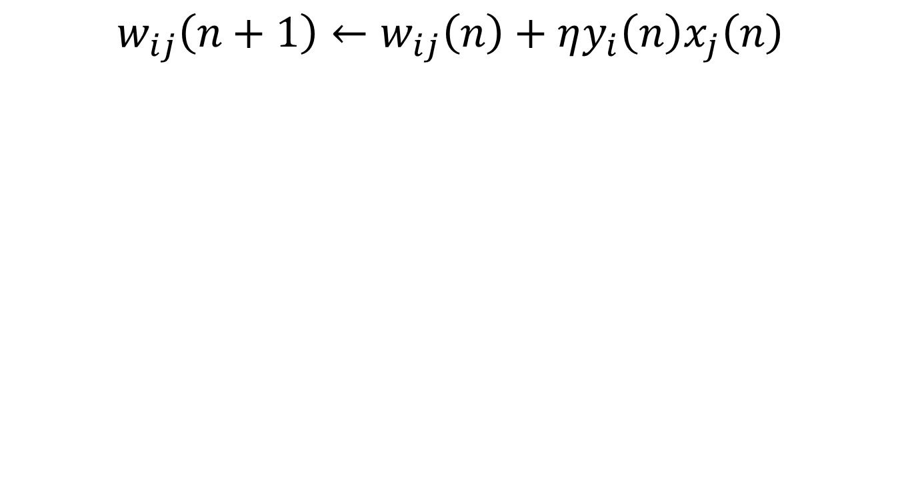
Biological plausibility
Hebbian learning

Slide 76
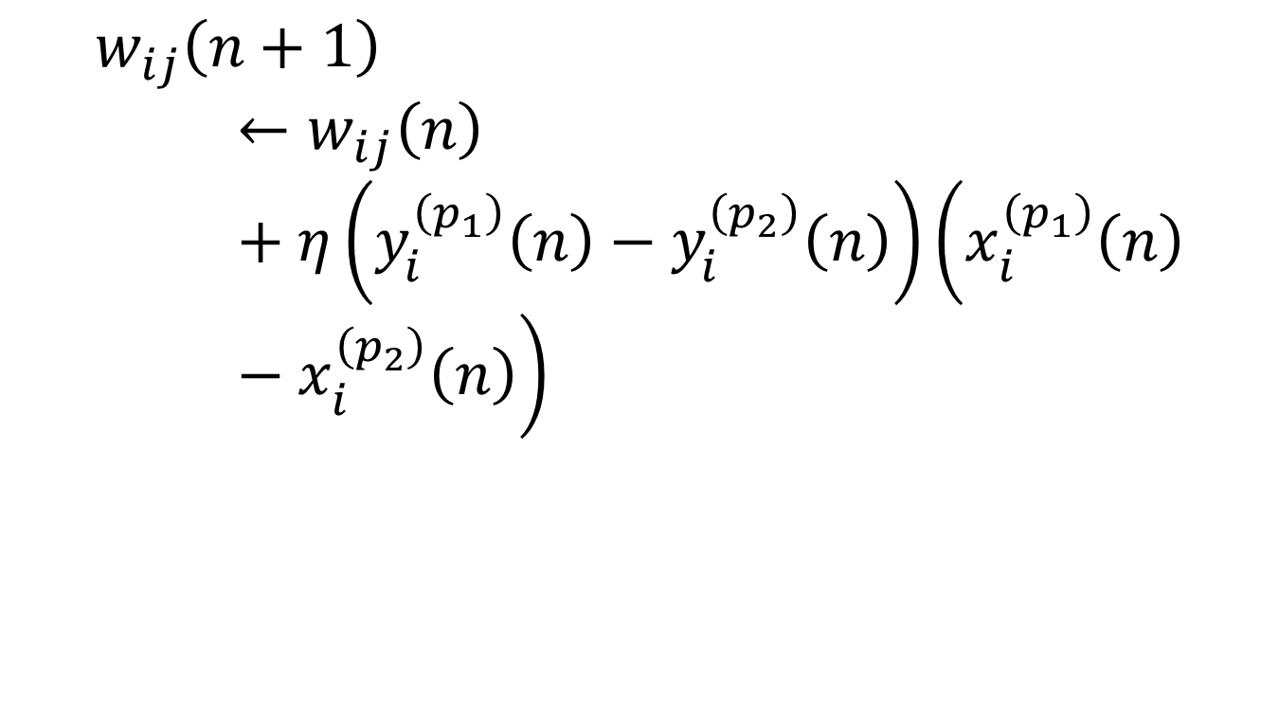
Resemble Hebbian learning
Single layer

Slide 77
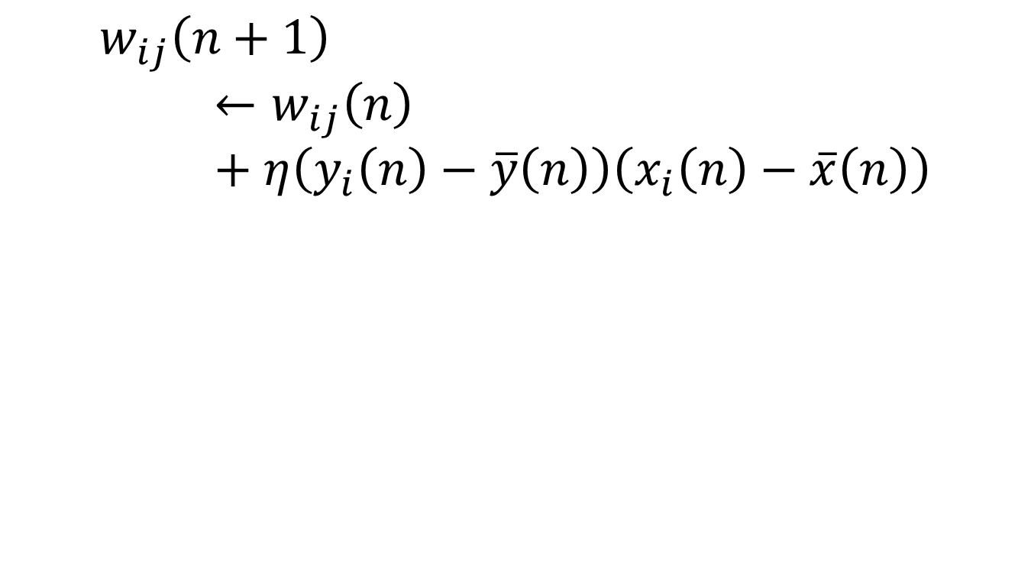
Similar hypothesis
Covariance hypothesis
Sejnowski TJ, 1977
Sejnowski TJ, 1997

Slide 78
Have a nice day.
Code in website
http://red.csie.ntu.edu.tw/NN/Classinfo/classinfo_eng.html

Slide 79
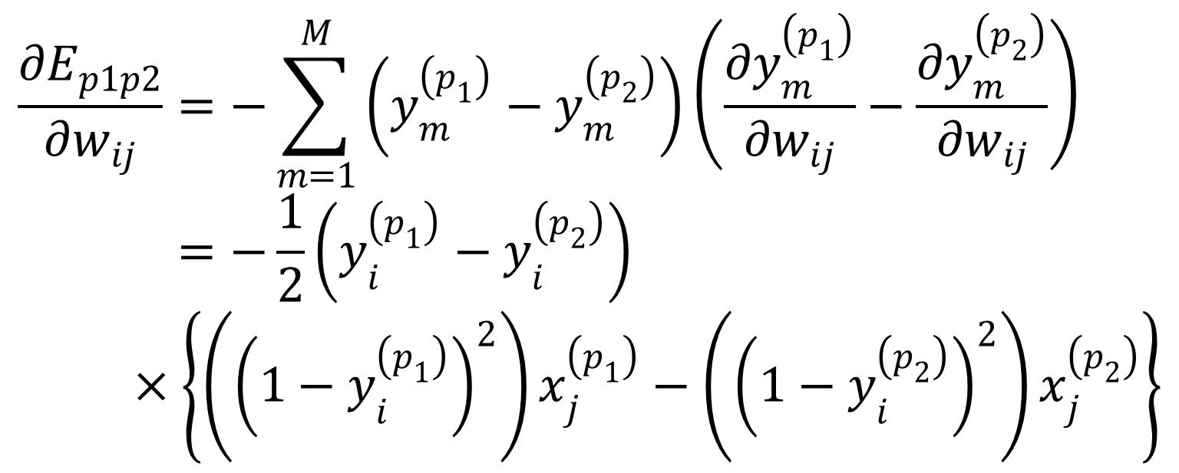
eq2
$$\frac{∂E_{p1p2}}{∂w_{ij}}=−\sum_{m=1}^{M}{\left(y_{m}^{\left(p_{1}\right)}−y_{m}^{\left(p_{2}\right)}\right)\left(\frac{∂y_{m}^{\left(p_{1}\right)}}{{∂w}_{ij}}−\frac{∂y_{m}^{\left(p_{2}\right)}}{{∂w}_{ij}}\right)} \\ =−\frac{1}{2}\left(y_{i}^{\left(p_{1}\right)}−y_{i}^{\left(p_{2}\right)}\right)×\left\{\left({\left(1−y_{i}^{\left(p_{1}\right)}\right)}^{2}\right)x_{j}^{\left(p_{1}\right)}−\left({\left(1−y_{i}^{\left(p_{2}\right)}\right)}^{2}\right)x_{j}^{\left(p_{2}\right)}\right\}$$

Slide 80
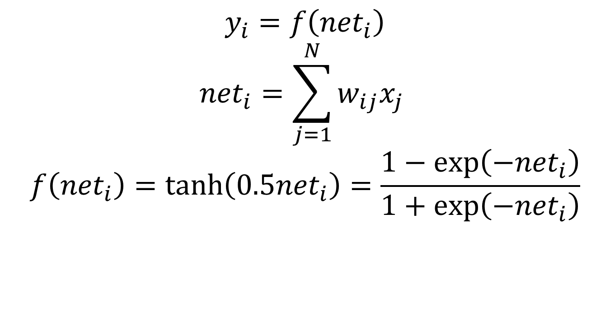
Eq 2 (continued)
$$y_{i}=f\left({net}_{i}\right)$$
$${net}_{i}=\sum_{j=1}^{N}{w_{ij}x_{j} }$$
$$f\left({net}_{i}\right)=\tanh\left(0.5{net}_{i}\right)=\frac{1−\exp\left(−{net}_{i}\right)}{1+\exp\left(−{net}_{i}\right)}$$

Slide 81
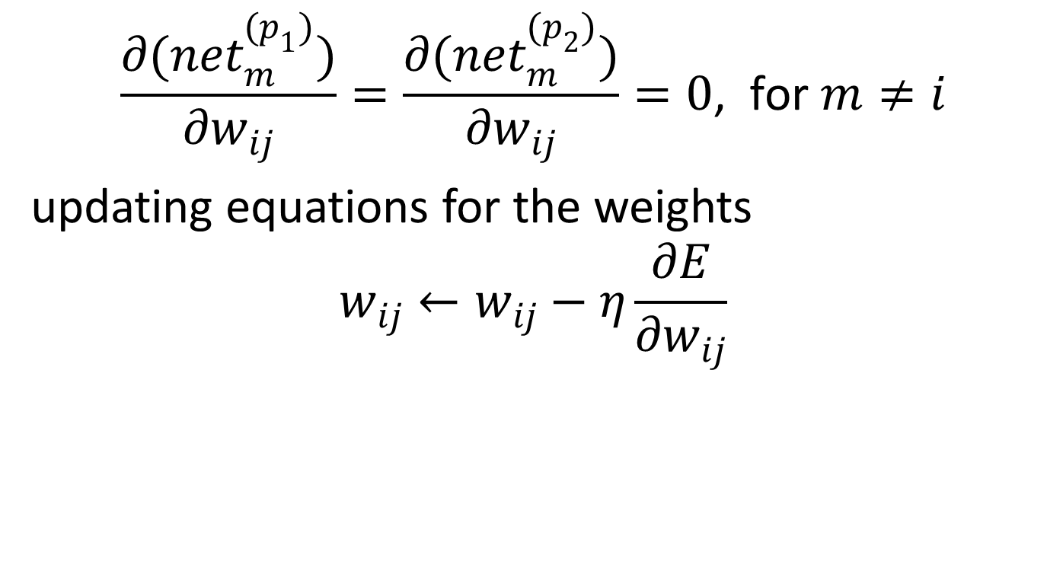
Eq 2 (continued)
$$\frac{∂({net}_{m}^{(p_{1})})}{∂w_{ij}}=\frac{∂({net}_{m}^{(p_{2})})}{∂w_{ij}}=0\text{, }\text{for} m≠i$$
updating equations for the weights
$$w_{ij}←w_{ij}−η\frac{∂E}{∂w_{ij}}$$

Slide 82

$$w_{i\left(N+1\right)}← \\ w_{i\left(N+1\right)}+\frac{η}{2}\left(y_{i}^{\left(p_{1}\right)}−y_{i}^{\left(p_{2}\right)}\right)\left({\left(y_{i}^{\left(p_{1}\right)}\right)}^{2}−{\left(y_{i}^{\left(p_{2}\right)}\right)}^{2}\right)$$

Slide 83
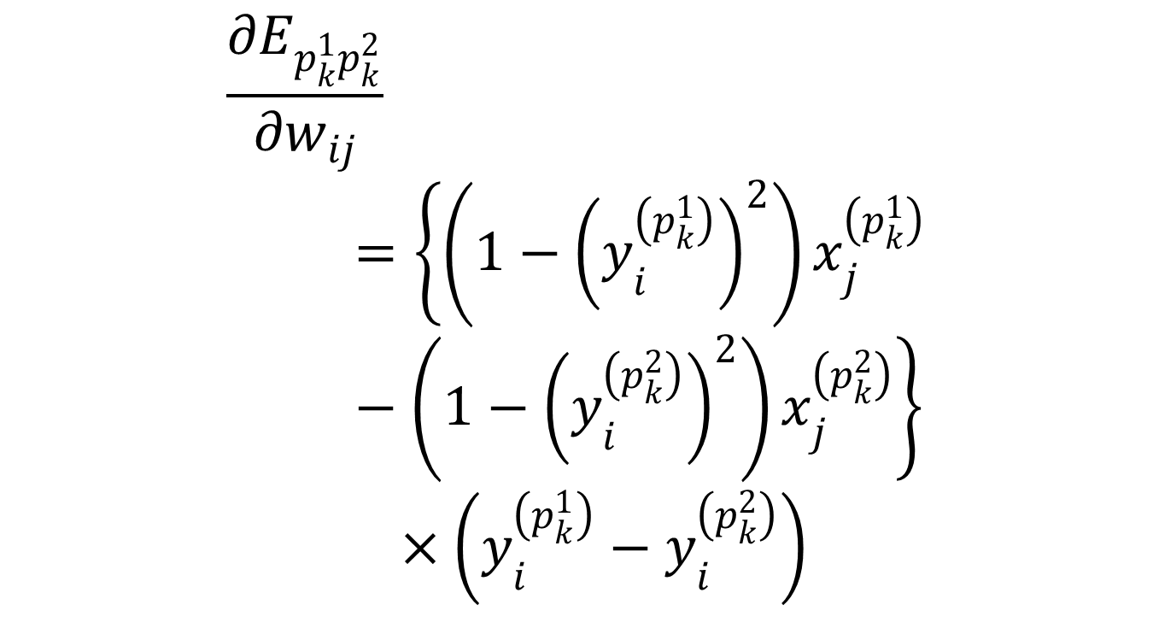
Eq 4
$$\frac{∂E_{p_{k}^{1}p_{k}^{2}}}{∂w_{ij}}=\left\{\left(1−{\left(y_{i}^{\left(p_{k}^{1}\right)}\right)}^{2}\right)x_{j}^{\left(p_{k}^{1}\right)}−\left(1−{\left(y_{i}^{\left(p_{k}^{2}\right)}\right)}^{2}\right)x_{j}^{\left(p_{k}^{2}\right)}\right\} \\ ×\left(y_{i}^{\left(p_{k}^{1}\right)}−y_{i}^{\left(p_{k}^{2}\right)}\right)$$

Slide 84

Eq 4 (continued)
$$E_{p_{k}^{1}p_{k}^{2}}=\frac{1}{2}{\left(d\left(y^{\left(p_{k}^{1}\right)},y^{\left(p_{k}^{2}\right)}\right)\right)}^{2}=\frac{1}{2}\sum_{i=1}^{M}{{\left(y_{i}^{\left(p_{k}^{1}\right)}−y_{i}^{\left(p_{k}^{2}\right)}\right)}^{2}}$$

Slide 85

Eq 5
$$w_{ij}←w_{ij}−η\frac{∂E_{p_{k}^{1}p_{k}^{2}}}{∂w_{ij}}$$

Slide 86

$$y_{i}^{A}=tanh\left(\sum_{j=1}^{N=256}{w_{ij}x_{j}^{A} }\right), ∀i=1,…,M$$

Slide 87
$$E=E_{AB}^{rep}=\frac{1}{2}\sum_{i=1}^{M=10}{{\left(y_{i}^{A}−y_{i}^{B}\right)}^{2}}$$

Slide 88
$$s\left(\left[U\right],\left[V\right]\right)=\frac{x^{U}}{\left|x^{U}\right|}∙\frac{x^{V}}{\left|x^{V}\right| }$$

Slide 89

$$δ_{o_{i}}=\frac{∂E}{∂o_{i}}\frac{∂o_{i}}{∂{net}_{i}}$$
$oi$ is obtained much as in Eq.2

Slide 90

$$δ_{o_{i}}^{\left(p_{1}\right)}=\left(o_{i}^{\left(p_{1}\right)}−o_{i}^{\left(p_{2}\right)}\right)\left(\frac{1}{2}{\left(1−\left(o_{i}^{\left(p_{1}\right)}\right)\right)}^{2}\right)$$
$$δ_{o_{i}}^{\left(p_{2}\right)}=\left(o_{i}^{\left(p_{1}\right)}−o_{i}^{\left(p_{2}\right)}\right)\left(\frac{1}{2}{\left(1−\left(o_{i}^{\left(p_{2}\right)}\right)\right)}^{2}\right)$$

Slide 91

$$δ_{z_{j}}^{(p_{1})}=\frac{1}{2}\left(1−{\left(z_{j}^{(p_{1})}\right)}^{2}\right)\sum_{r}{δ_{o_{r}}^{(p_{1})}w_{rj}}$$
$$δ_{z_{j}}^{(p_{2})}=\frac{1}{2}\left(1−{\left(z_{j}^{(p_{2})}\right)}^{2}\right)\sum_{r}{δ_{o_{r}}^{(p_{2})}w_{rj}}$$
$$δ_{y_{k}}^{(p_{1})}=\frac{1}{2}\left(1−{\left(y_{k}^{(p_{1})}\right)}^{2}\right)\sum_{r}{δ_{z_{r}}^{(p_{1})}v_{rk}}$$
$$δ_{y_{k}}^{(p_{2})}=\frac{1}{2}\left(1−{\left(y_{k}^{(p_{2})}\right)}^{2}\right)\sum_{r}{δ_{z_{r}}^{(p_{2})}v_{rk}}$$

Slide 92

ch5
{{$v_{ki}←v_{ki}+η\frac{1}{2}\left(x_{k}^{p}−x_{k}^{′}\right)\left(1−{\left(x_{k}^{′}\right)}^{2}\right)y_{i}^{\left(p\right)}$}}

Slide 93
Ch5 eq7
$$w_{ij}\left(n+1\right)←w_{ij}\left(n\right)+η\left(y_{i}^{\left(p_{1}\right)}\left(n\right)−y_{i}^{\left(p_{2}\right)}\left(n\right)\right)\left(x_{i}^{\left(p_{1}\right)}\left(n\right)−x_{i}^{\left(p_{2}\right)}\left(n\right)\right)$$

Slide 94
Ch5 eq8
$$w_{ij}\left(n+1\right)←w_{ij}\left(n\right)+ηy_{i}\left(n\right)x_{j}\left(n\right)$$

Slide 95
Ch5 eq9
$$w_{ij}\left(n+1\right)←w_{ij}\left(n\right)+η\left(y_{i}\left(n\right)−\overline{y}\left(n\right)\right)\left(x_{i}\left(n\right)−\overline{x}\left(n\right)\right)$$

